Slide 1
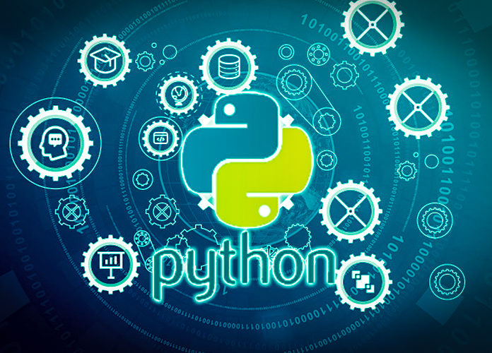
Data Programming in Python Python Data Analytics Libraries

Slide 2
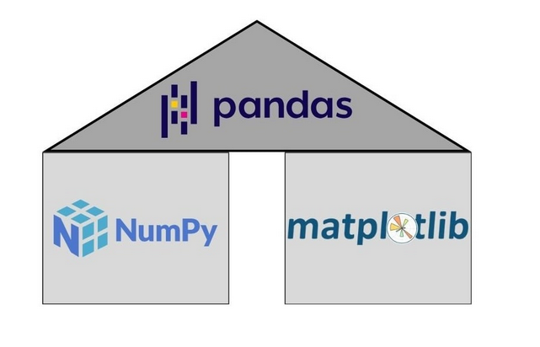
Different Packages
NumPy (Mathematical Arrays)
Pandas (Dataframe Analysis)
Matplotlib (Graphing/Visualization)
Seaborn (Graphing/Datasets)
Scikitlearn (Machine Learning)

Slide 3
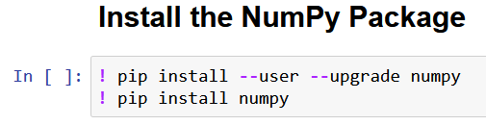
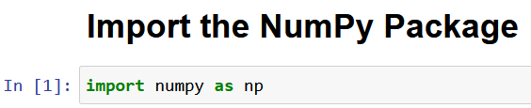
Installing and Importing
Installing:
Only once on machine
Importing:
Every time launching notebook

